Slide 1

K-means-based Consensus Clustering
Algorithm, Theory and Applications
Speaker: Hongfu Liu
Email: hongfuliu@brandeis.edu

Slide 2

Something about me
Education
Current
Assistant Professor at Department of Computer Science, Brandeis University
Previous
Ph.D. in Computer Engineering, Northeastern University (2014-2018)
Master in Management, Beihang University (2011-2014)
Bachelor in Management, Beihang University (2007-2011)
Minor Bachelor, in Applied Mathematics, Beihang University (2007-2011)
Minor Bachelor, in Law, Beihang University (2007-2011)
Internship
Microsoft Research Asia (6/2017-8/2017)
Adobe Research (5/2016-7/2016)

Slide 3


Research and Publication
Research Objectives
Seek shortcuts in the labyrinth
Handle emerging topics in practical scenarios
Achievements
Publications T-style
Conference - KDD, ICDM, SDM, AAAI, IJCAI, CIKM
Journal - TPAMI, TKDE, TIP, TFS, TKDD, DMKD, BMC
Honors
First Place Award in ICCV Challenge
KDD Top 20 raising star
Constrained Clustering
Outlier Detection
Domain Adaptation
Feature Selection
Adversarial Ensemble Clustering
Infinite Ensemble Clustering
Spectral Ensemble Clustering
K-means-based Consensus Clustering
K-means Optimization

Slide 4
Outline
Cluster Analysis
Consensus Clustering
From Consensus Clustering to K-means Clustering
K-means-based Consensus Clustering [IJCAI-13, SDM-15, TKDE-15, BMC-17]
Spectral Ensemble Clustering [KDD-15, CIKM-16, TKDE-17]
Infinite Ensemble Clustering [KDD-16, DMKD-17]
Other Related Topics
Conclusion
Consensus Clustering
Utility based method
KCC
Co-association Matrix based method
SEC

Slide 5
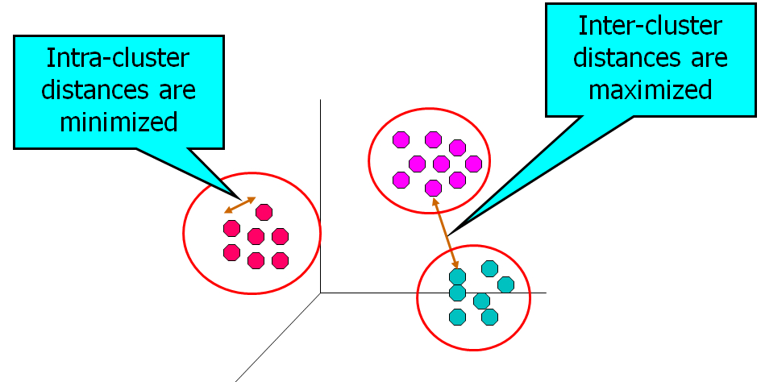


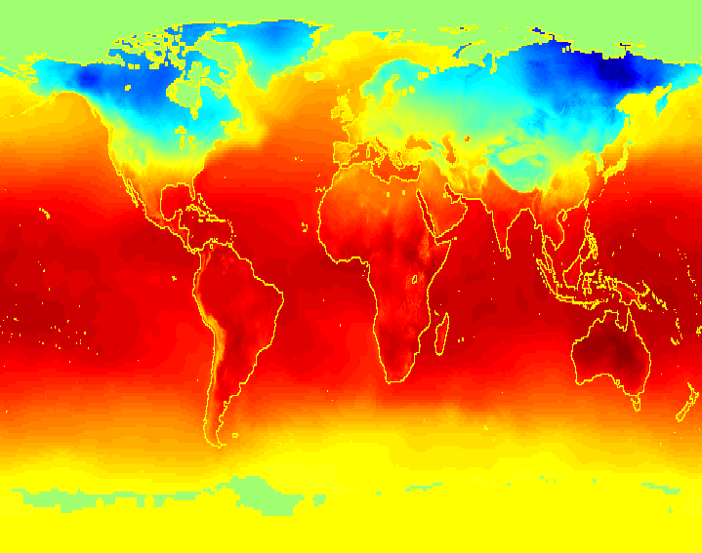


Cluster Analysis
Cluster analysis is a core technique in machine learning and artificial intelligence

Slide 6
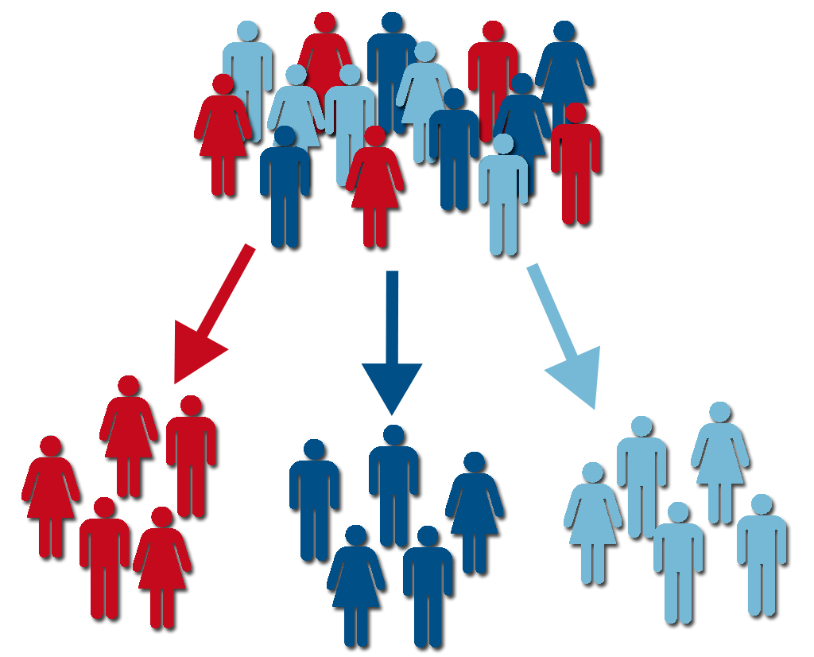

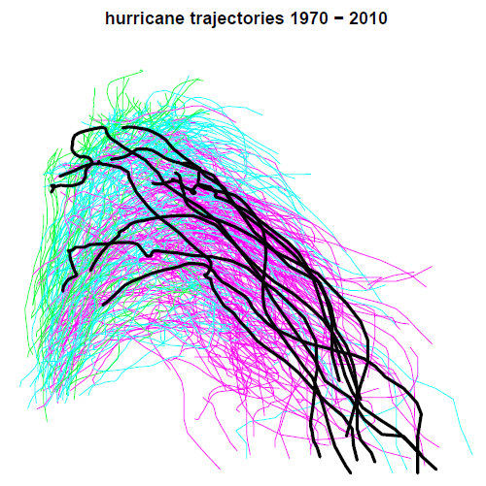


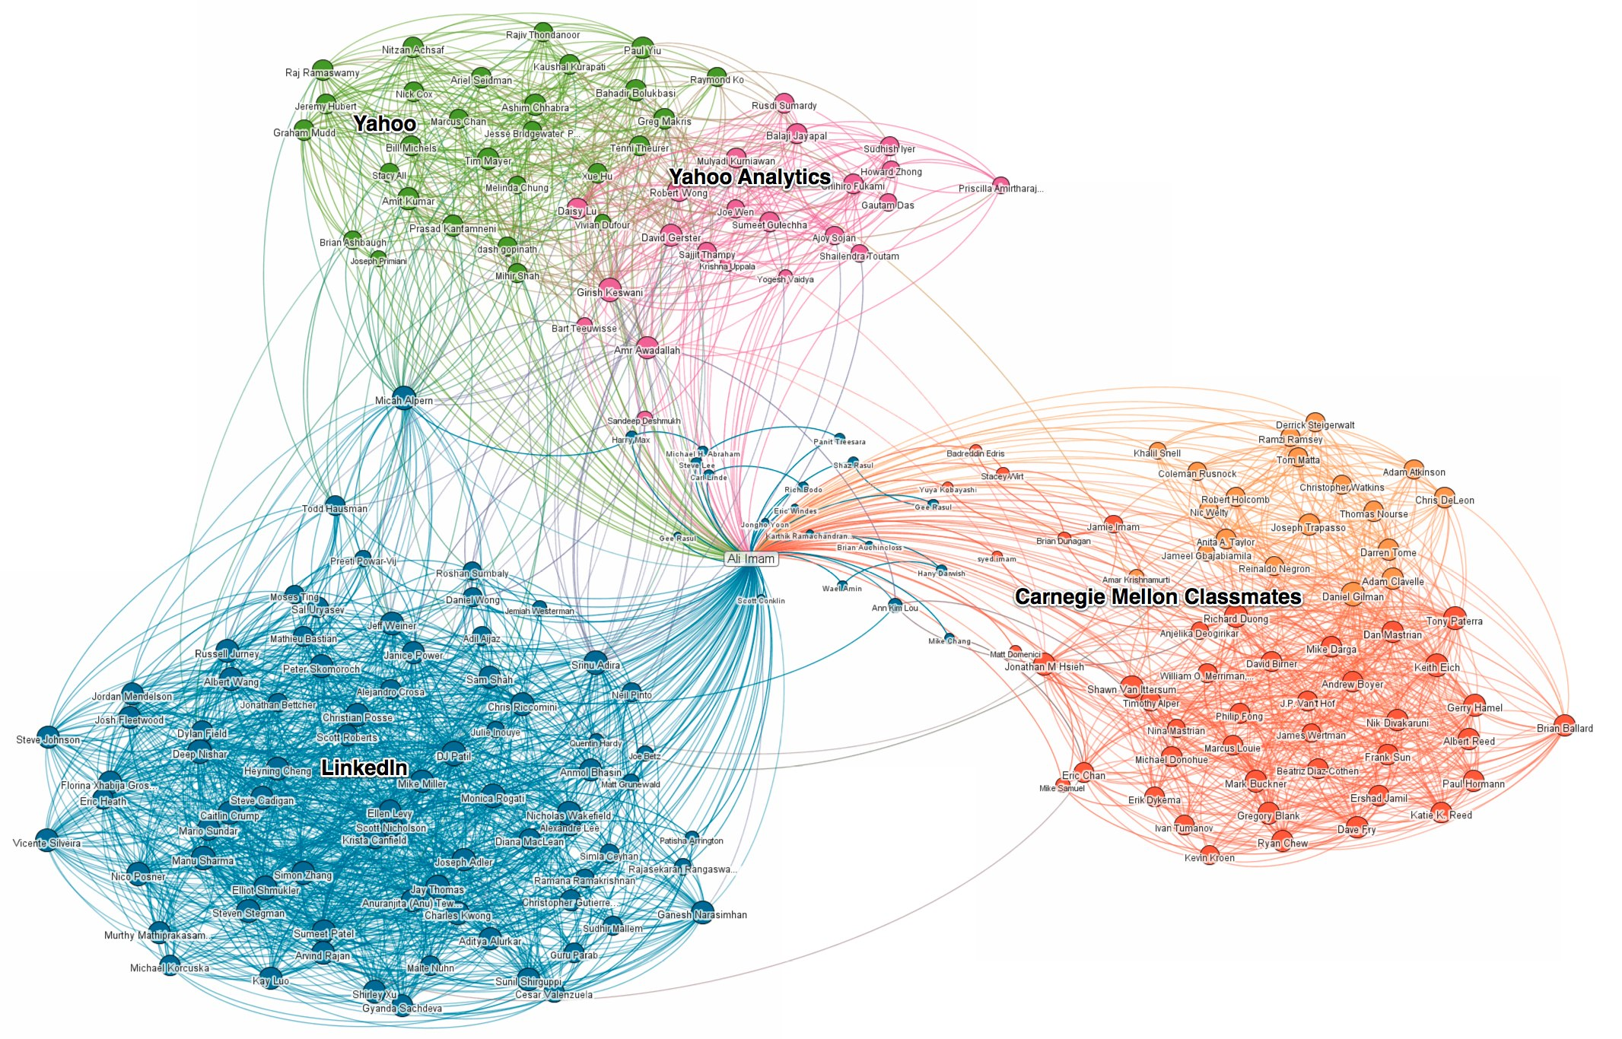
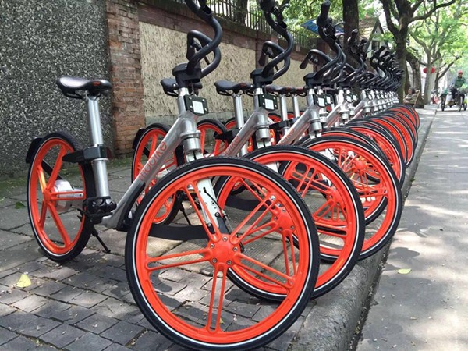

Cluster Analysis
Customer segmentation
City planning
Outlier detection
Superpixel segmentation
Big data visualization
Recommendation system
Resource organization
Saliency detection
By Google images

Slide 7
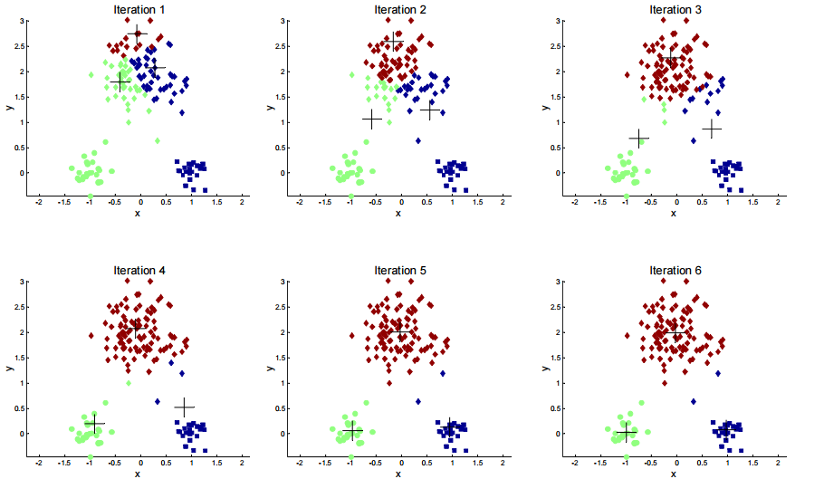
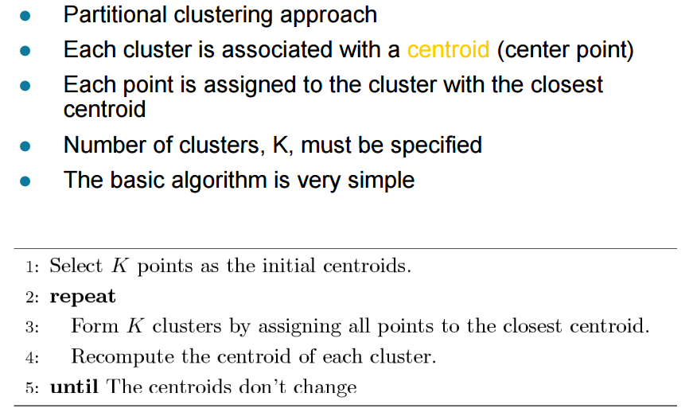
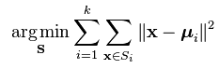
Cluster Analysis
K-means clustering

Slide 8
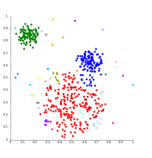
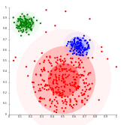
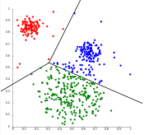
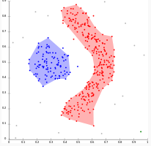

Traditional vs Consensus Clustering
Many clustering algorithms have been proposed
Connectivity models, AHC
Centroid models, K-means
Distribution models, EM
Density models, DBSCAN
Subspace models, SSC
Graph-based models, Spectral Clustering
Why Consensus Clustering?
Cluster analysis is an unsupervised task
Different algorithms return different results
Some have lots of parameters to tune
Some suffer from low robustness

Slide 9
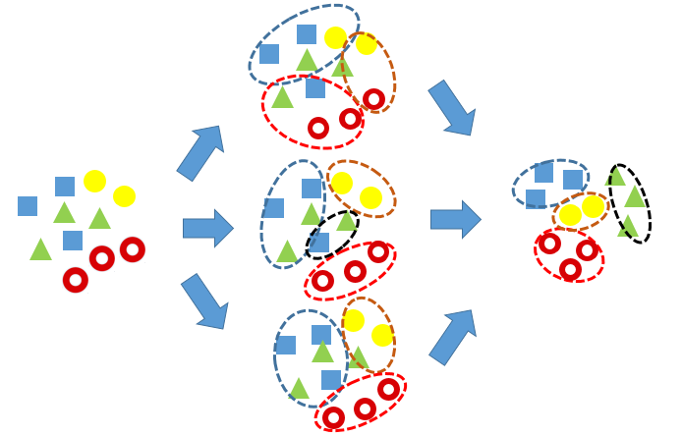
Consensus Clustering
Consensus Clustering, also known as Ensemble Clustering or Cluster Aggregation, aims to find a single partition that most agrees with multiple existing basic partitions
Why Ensemble Clustering?
Problems with Single Clustering
No perfect one!
Sensitive to data factors
Hard to set proper parameters
May converge to bad saddle points
Or just too heuristic
Advantages of Ensemble Clustering
Robust: lower the risks from weird data,
improper algorithms and parameters, etc.
Novelty: help find a better solution
Distributed
Knowledge reuse
Privacy

Slide 10
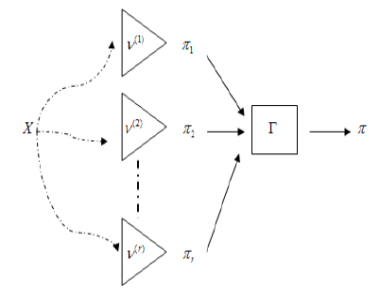
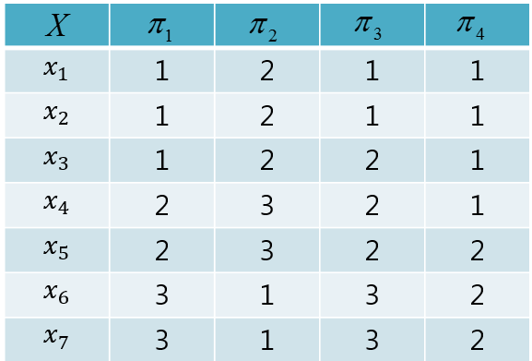
Consensus Clustering
Basic concepts
Data set
Basic partitions
Consensus clustering
Utility function

Slide 11
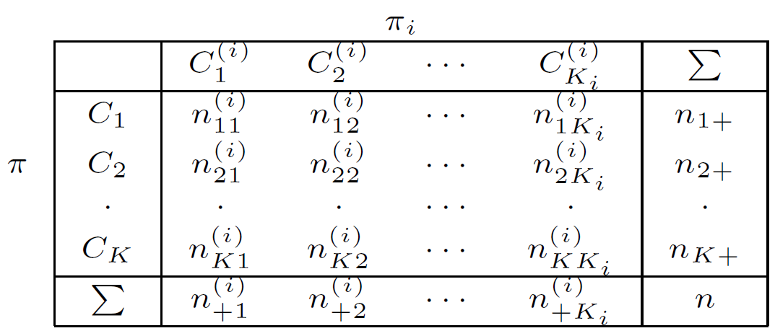
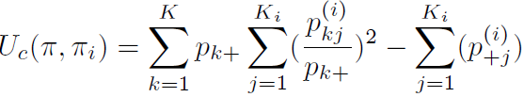
Consensus Clustering
Ensemble Clustering can be roughly divided into two categories:
Those with explicit objective function
K-means-based method
Non-negative matrix factorization
Kernel-based methods
EM algorithm
Simulated annealing
Those with implicit objective function
Graph-based algorithms
Co-association matrix-based methods
Relabeling and voting methods
Hierarchical ensemble clustering
In general, compared with methods with implicit objective function, methods with explicit objective function might offer better interpretability and higher robustness to clustering results, via the guidance of objective functions. However, they often bear high computational costs.
Utility function: to measure the similarity between consensus clustering and basic partition
Eg: Category Utility Function

Slide 12
Outline
Cluster Analysis
Consensus Clustering
From Consensus Clustering to K-means Clustering
K-means-based Consensus Clustering [IJCAI-13, SDM-15, TKDE-15, BMC-17]
Spectral Ensemble Clustering [KDD-15, CIKM-16, TKDE-17]
Infinite Ensemble Clustering [KDD-16, DMKD-17]
Other Related Topics
Teaching and Fund Experience
Conclusion
Consensus Clustering
Utility based method
KCC
Co-association Matrix based method
SEC

Slide 13
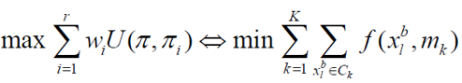
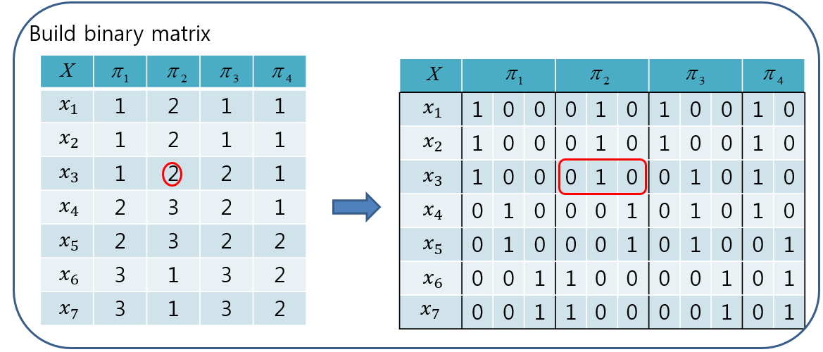
K-means-based Consensus Clustering
Benefits
Simple
Theoretical support
Good performance
Heterogeneous data
Incomplete data
Large-scale data
Exact mapping
Consensus Clustering
K-means Clustering
A complex problem
Time consuming
A well-defined problem
Roughly linear time complexity
What kind of utility function?

Slide 14
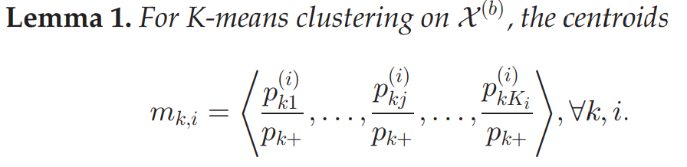
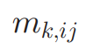
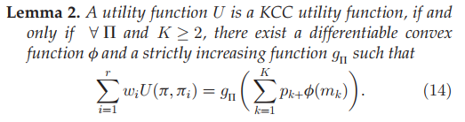

K-means-based Consensus Clustering
What kind of utility function can be used for the K-means clustering solution?
KCC Utility Function
We have two findings
Category Utility Function
a constant
=

Slide 15
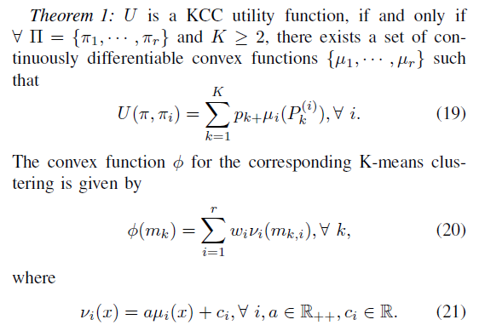

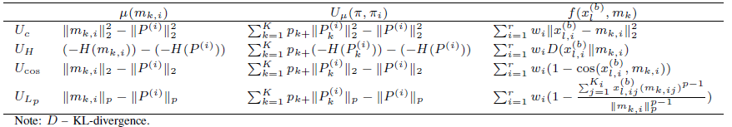
K-means-based Consensus Clustering
KCC utility function
i-th part of k-th centroid
K-means

Slide 16
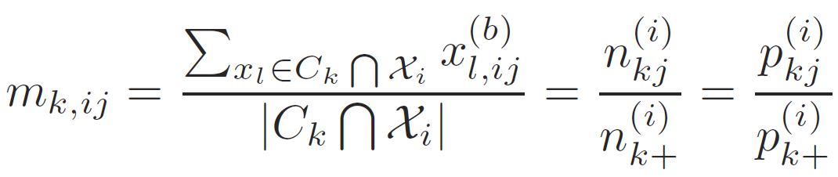
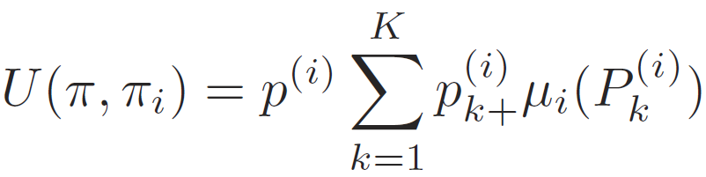
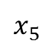
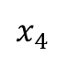
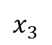
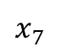
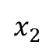
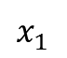
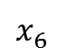
K-means-based Consensus Clustering
Extension 1: how to employ KCC to handle incomplete basic partitions?
Missing labels provide no utility
For the utility function, we have
 | 1 | 2 | 1 | 1
 | 1 | ? | 1 | 1
 | ? | 2 | 2 | 1
 | 2 | 3 | 2 | 1
 | 2 | ? | 2 | 1
 | 3 | 1 | 3 | 2
 | 3 | 1 | 3 | ?
 | 1 | 0 | 0 | 0 | 1 | 0 | 1 | 0 | 0 | 1 | 0
 | 1 | 0 | 0 | 0 | 0 | 0 | 1 | 0 | 0 | 1 | 0
 | 0 | 0 | 0 | 0 | 1 | 0 | 0 | 1 | 0 | 1 | 0
 | 0 | 1 | 0 | 0 | 0 | 1 | 0 | 1 | 0 | 1 | 0
 | 0 | 1 | 0 | 0 | 0 | 0 | 0 | 1 | 0 | 0 | 1
 | 0 | 0 | 1 | 1 | 0 | 0 | 0 | 0 | 1 | 0 | 1
 | 0 | 0 | 1 | 1 | 0 | 0 | 0 | 0 | 1 | 0 | 0
$$x_{1}$$
$$x_{1}$$
$$x_{2}$$
$$x_{2}$$
$$x_{3}$$
$$x_{3}$$
$$x_{4}$$
$$x_{4}$$
$$x_{5}$$
$$x_{5}$$
$$x_{6}$$
$$x_{6}$$
$$x_{7}$$
$$x_{7}$$
The weight of incomplete basic partition
naturally turns down

Slide 17
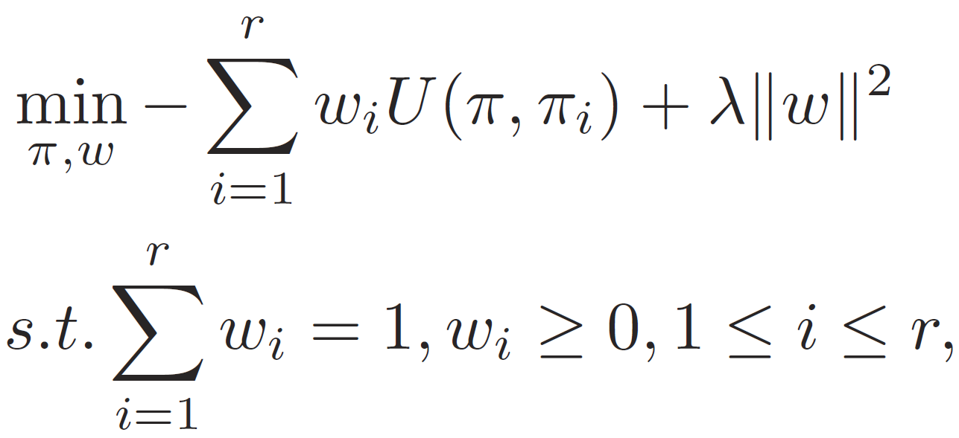
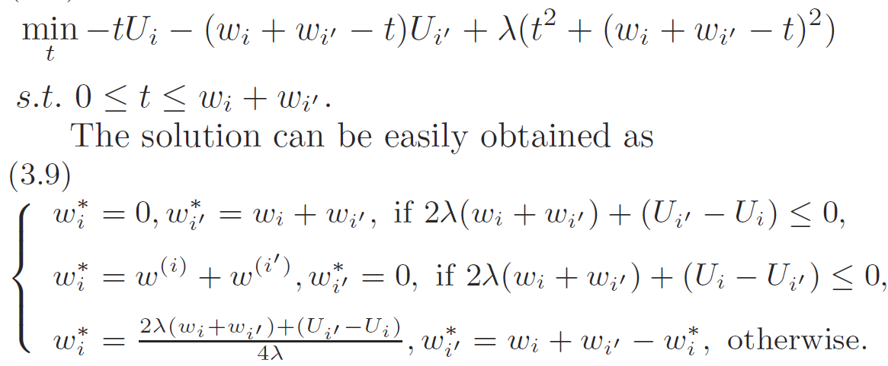

K-means-based Consensus Clustering
Extension 2: Can we automatically learn the weights of basic partitions?
Fixed weights, update the consensus partition by KCC
Fixed the consensus partition, update the weights
Update two elements while keeping the others fixed
Yes, we can. But we DO NOT need.

Slide 18
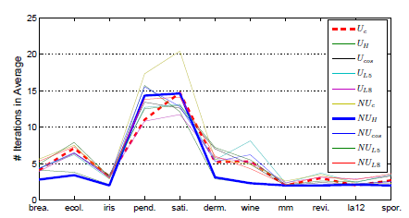
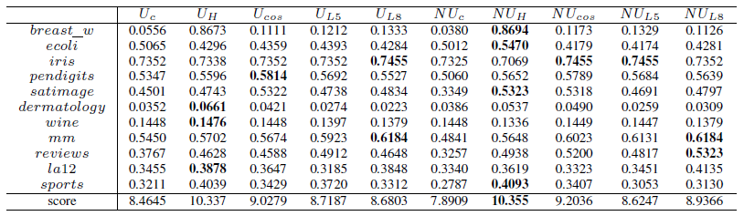
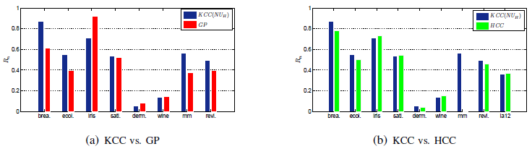
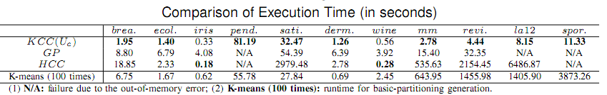
K-means-based Consensus Clustering
KCC enjoys the high efficiency and robust performance.

Slide 19
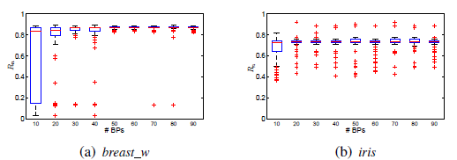
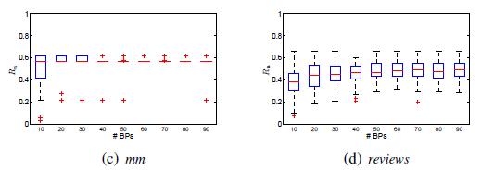
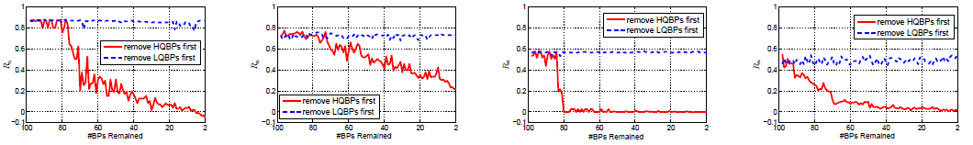
K-means-based Consensus Clustering
This phenomenon leads to infinite ensemble clustering
Number of Basic Partitions
Quality of Basic Partitions
The quality and diversity of basic partitions are key factors to the success of consensus clustering.

Slide 20
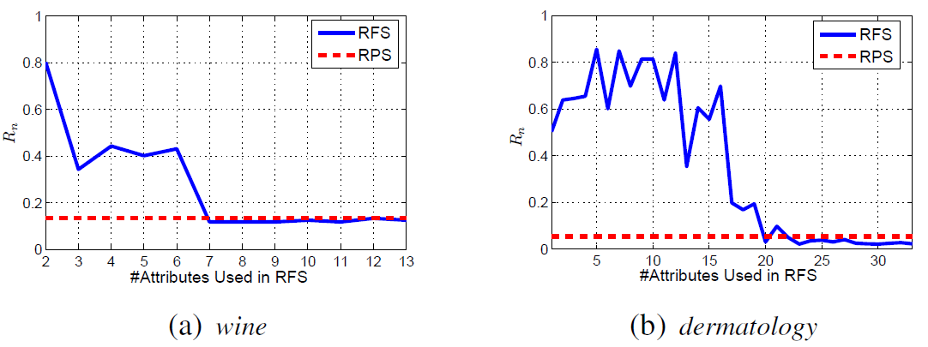
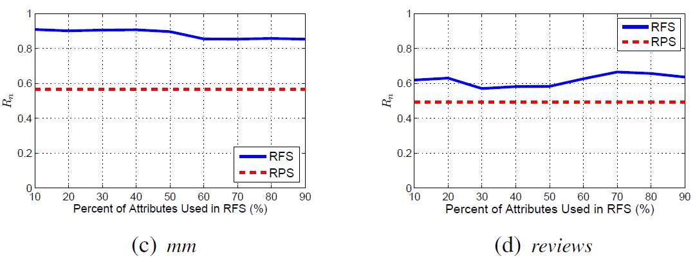
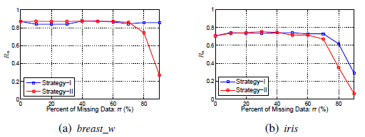
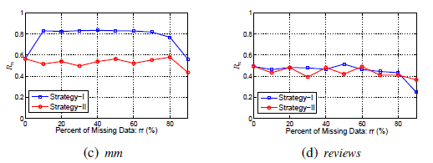
K-means-based Consensus Clustering
Generation Strategy of Basic Partitions
Performances on Incomplete Basic Partitions

Slide 21
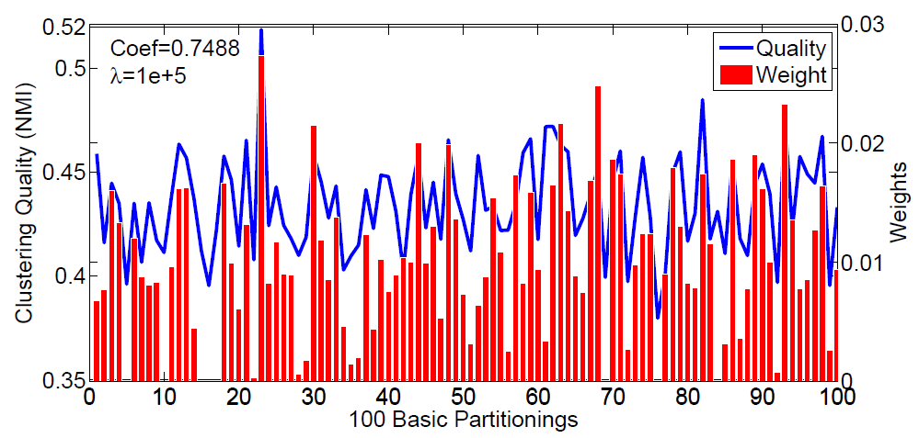
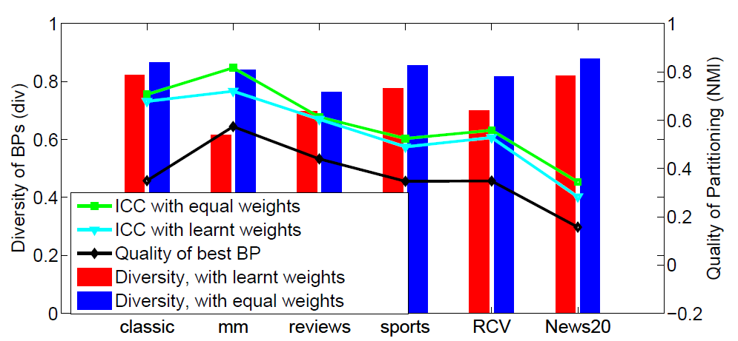
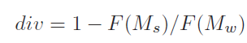



K-means-based Consensus Clustering
Weight learning
You cannot improve yourself only by yourself.
F denotes the Frobenius norm of a matrix
A large div indicates a higher diversity
Weight learning can help find the high quality basic partitions in the unsupervised fashion
Weight learning does not help to boost the performance
(a) classic
(b) mm

Slide 22


K-means-based Consensus Clustering
Summary
A theoretical study on KCC Utility Function, which leads the consensus clustering into K-means clustering
Handle the incomplete data, discuss the weight learning
Give some empirical results for practical use
Text clustering
Pan-omics gene expression analysis

Slide 23
Outline
Cluster Analysis
Consensus Clustering
From Consensus Clustering to K-means Clustering
K-means-based Consensus Clustering [IJCAI-13, SDM-15, TKDE-15, BMC-17]
Spectral Ensemble Clustering [KDD-15, CIKM-16, TKDE-17]
Infinite Ensemble Clustering [KDD-16, DMKD-17]
Other Related Topics
Teaching and Fund Experience
Conclusion
Consensus Clustering
Utility based method
KCC
Co-association Matrix based method
SEC

Slide 24


Spectral Ensemble Clustering
Recall the second consensus clustering is based on co-association matrix.
The co-association matrix-based method:
Step 1 : Build co-association matrix (regarded as a similarity matrix between data pairs)
Step 2 : A graph partition method can be used to obtain the final consensus clustering
Advantages:
The consensus clustering problem can be defined as a classical graph partition problem
Graph partition methods can directly exploit the co-association matrix
Disadvantages:
Huge time and space complexities

Slide 25

Spectral Ensemble Clustering
What is Spectral Ensemble Clustering?
It applies spectral clustering on the co-association matrix S to obtain final consensus clustering
The objective function of SEC:
It seems that SEC suffers the same problem with other co-association matrix-based methods
Why SEC?
We have an elegant and equivalent way to solve the above problem efficiently

Slide 26










Spectral Ensemble Clustering
SEC is theoretically equivalent to a weighted K-means clustering problem
Theorem 1:
$$\max{\frac{1}{K}}tr\left(Z^{T}D^{−1/2}SD^{−1/2}Z\right)⇔\sum_{i=1}^{n}{f_{m_{1},…,m_{K}}\left(x_{i}\right)},$$
where $f_{m_{1},…,m_{K}}\left(x\right)=\min_{k}{w_{b}\left(x\right){\left\|\frac{b(x)}{w_{b}(x)}−m_{k}\right\|}^{2} }$,
$diag\left(w_{b}(x)\right)=D$, and $m_{k}=\frac{\sum_{x∈C_{k}}{b(x)}}{\sum_{x∈C_{k}}{w_{b}(x)}}$.
Equivalent transformation
 | 1 | 0 | 0 | 0 | 1 | 0 | 1 | 0 | 0 | 1 | 0
 | 1 | 0 | 0 | 0 | 1 | 0 | 1 | 0 | 0 | 1 | 0
 | 1 | 0 | 0 | 0 | 1 | 0 | 0 | 1 | 0 | 1 | 0
 | 0 | 1 | 0 | 0 | 0 | 1 | 0 | 1 | 0 | 1 | 0
 | 0 | 1 | 0 | 0 | 0 | 1 | 0 | 1 | 0 | 0 | 1
 | 0 | 0 | 1 | 1 | 0 | 0 | 0 | 0 | 1 | 0 | 1
 | 0 | 0 | 1 | 1 | 0 | 0 | 0 | 0 | 1 | 0 | 1
$$w$$
 | 1/12 | 0 | 0 | 0 | 1/12 | 0 | 1/12 | 0 | 0 | 1/12 | 0
 | 1/12 | 0 | 0 | 0 | 1/12 | 0 | 1/12 | 0 | 0 | 1/12 | 0
 | 1/13 | 0 | 0 | 0 | 1/13 | 0 | 0 | 1/13 | 0 | 1/13 | 0
 | 0 | 1/11 | 0 | 0 | 0 | 1/11 | 0 | 1/11 | 0 | 1/11 | 0
 | 0 | 1/10 | 0 | 0 | 0 | 1/10 | 0 | 1/10 | 0 | 0 | 1/10
 | 0 | 0 | 1/8 | 1/8 | 0 | 0 | 0 | 0 | 1/8 | 0 | 1/8
 | 0 | 0 | 1/8 | 1/8 | 0 | 0 | 0 | 0 | 1/8 | 0 | 1/8
12
12
13
11
10
8
8
Remark
We transform SEC into weighted K-means clustering in an explicit theoretically equivalent way
The time complexity decreases from O(n³) to O(n)
The space complexity decreases from O(n²) to O(n)
$$x_{1}$$
$$x_{1}$$
$$x_{2}$$
$$x_{2}$$
$$x_{3}$$
$$x_{3}$$
$$x_{4}$$
$$x_{4}$$
$$x_{5}$$
$$x_{5}$$
$$x_{6}$$
$$x_{6}$$
$$x_{7}$$
$$x_{7}$$

Slide 27


Spectral Ensemble Clustering
Next, we derive the intrinsic consensus utility function of SEC from the view point of weighted K-means clustering
Theorem 2: The utility function of SEC is
$$U\left(π,π_{i}\right)=\sum_{k=1}^{K}{\frac{n_{k+}}{w_{C_{k}}}p_{k+}\sum_{j=1}^{K_{i}}{{\left(\frac{p_{kj}^{(i)} }{p_{k+}}\right)}^{2}}}.$$
Consensus clustering with explicit objective function
Remark
We build a bridge between co-association matrix-based method and other consensus clustering algorithms with explicit utility function
Similarity on instance-level and partition-level can be interconvertible

Slide 28

Spectral Ensemble Clustering
Effectiveness and Efficiency of SEC

Slide 29



Spectral Ensemble Clustering
Stability and Scalability of SEC

Slide 30


Spectral Ensemble Clustering
SEC Applied to Big Weibo Data
Sina Weibo data
97,231,274 tweets published on the platform on Sept. 1st 2013
Remove advertisement-related tweets
Remained data: 61,212,950 instances and 10,000 dimensions
Apply SEC with row-segmentation strategy

Slide 31


Spectral Ensemble Clustering
Summary
We propose SEC and uncover an equivalent relationship with weighted K-means clustering that dramatically decreases the time and space complexity.
Equivalent transform
Robustness & Generalizability Analysis
Build the bridge of two categories algorithm
Incomplete Basic Partitions Clustering

Slide 32
Outline
Cluster Analysis
Consensus Clustering
From Consensus Clustering to K-means Clustering
K-means-based Consensus Clustering [IJCAI-13, SDM-15, TKDE-15, BMC-17]
Spectral Ensemble Clustering [KDD-15, CIKM-16, TKDE-17]
Infinite Ensemble Clustering [KDD-16, DMKD-17]
Other Related Topics
Teaching and Fund Experience
Conclusion
Consensus Clustering
Utility based method
KCC
Co-association Matrix based method
SEC

Slide 33
Infinite Ensemble Clustering
Recall that the performance of consensus clustering goes up with the increase of the number of basic partitions.
What is the best number of basic partitions for a given dataset?
What about fusing infinite basic partition?

Slide 34


Infinite Ensemble Clustering
It is crazy and impossible to generate infinite basic partitions.
What we want is the expectation of the co-association matrix.
Since the expectation of co-association matrix cannot be obtained in advance, we intend to calculate it during the optimization.
We corrupt the basic partitions and marginalize them for the expectation.
By adding drop-out noise to basic partitions, some elements are set to be zero, which leads to incomplete basic partitions.
D. Luo, C. Ding, H. Huang, and F. Nie. Consensus spectral clustering in near-linear time. In Proceedings of International Conference on Data Engineering, 2011.

Slide 35




Infinite Ensemble Clustering
Cluster Performance
Execution Time

Slide 36




Infinite Ensemble Clustering
Evaluation by survival analysis on 13 pan-omics gene expression data sets

Slide 37
Outline
Cluster Analysis
Consensus Clustering
From Consensus Clustering to K-means Clustering
K-means-based Consensus Clustering [IJCAI-13, SDM-15, TKDE-15, BMC-17]
Spectral Ensemble Clustering [KDD-15, CIKM-16, TKDE-17]
Infinite Ensemble Clustering [KDD-16, DMKD-17]
Other Related Topics
Teaching and Fund Experience
Conclusion
Consensus Clustering
Utility based method
KCC
Co-association Matrix based method
SEC

Slide 38

Consensus Clustering
My work along consensus clustering
Consensus Clustering
Simultaneous Clustering and Ensemble
Infinite Ensemble Clustering
Adversarial Ensemble Clustering
K-means-based Consensus Clustering
Fuzzy C-means Consensus Clustering
Spectral Ensemble Clustering
38

Slide 39


Other Related Topics
Consensus Clustering
Structure-Preserved Learning
Interpretable Clustering via Semantic Recover
Partition Level Constrained Clustering
Application
Heterogenous Domain Adaptation
Multi-view Clustering
Feature Selection
Bi-sampling Outlier Detection
Zombie User Detection
Image Co-segmentation
K-means Clustering

Slide 40




Constrained Clustering
To further improve the performance, semi-supervised clustering or constrained clustering comes into being, which incorporates pre-known information or side information into the process of clustering.

Slide 41


Heterogenous Domain Adaptation
Domain adaptation aims to employ the auxiliary source domain data to facilitate the task on the target domain.
Heterogenous domain adaptation: the source and target data with different feature representations.
No way to learn a classifier on the source domain and adapting it for the target data
There are no labeled target data to guide the common space learning.

Slide 42



Interpretable Clustering via Semantic Recover
When we obtain the partition, the natural question is what do the cluster mean.
Features are used to understand the meaning of the clusters. However, if the features do not have the semantic or physical meaning, how could we understand that?

Slide 43


Conclusion
For the two categories of consensus clustering, we transform them into simple K-means clustering in a efficient and elegant way.
My interests are just to seek these shortcuts in the labyrinth.
Hongfu Liu liu.hongf@husky.neu.edu

